Slide 1
Spark SQL -Introduction
Pravin Y Pawar

Slide 2
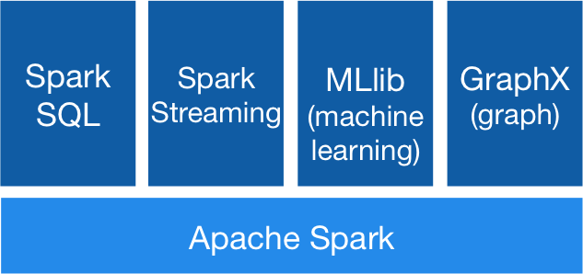
Spark Components
Spark Architectural Component

Slide 3
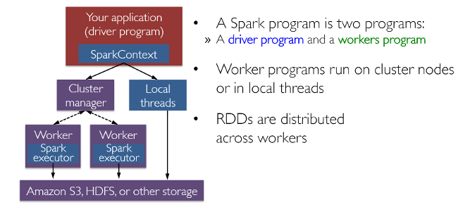
Spark Application Execution
Cluster Components

Slide 4
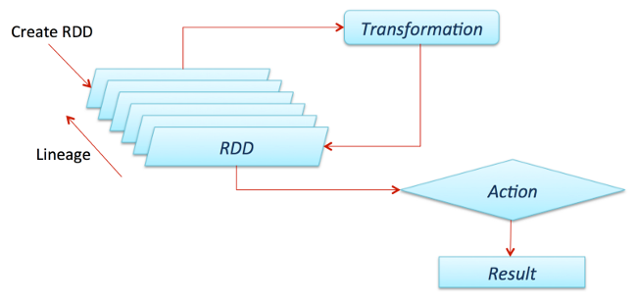
Spark RDD
Main Abstraction of Spark
The biggest contributor behind all of Spark's success stories
A data structure, or rather a distributed memory abstraction
that allows programmers to perform in-memory computations on large distributed clusters while retaining aspects like fault tolerance
That parallelize a lot of computations and transformations and track the whole lineage of transformations, which can help in efficiently recomputing lost data
RDD Paper

Slide 5
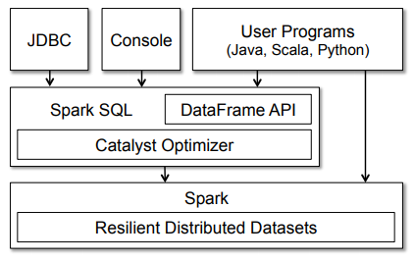
Spark SQL Architecture

Slide 6
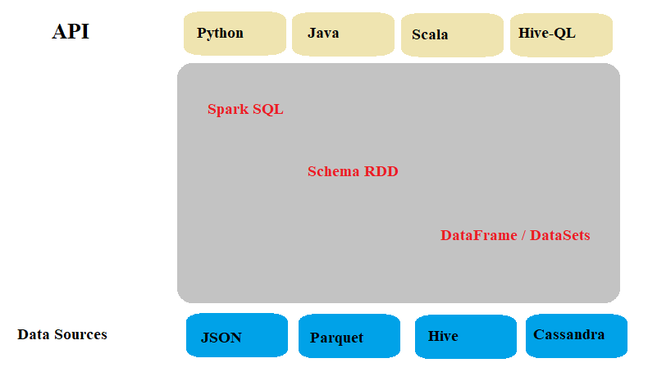
Spark SQL Architecture (2)
Another View

Slide 7
Spark SQL Interfaces
SQLContext
entry point for working with structured data (rows and columns) in Apache Spark
Allows the creation of DataFrame objects as well as the execution of SQL queries
DataFrame
is equivalent to the relational table in Spark SQL but with richer optimization
is a distributed collection of data in the form of named column and row
For accessing data frames either SQL Context or Hive Context is needed
Hive Context
Used while working with Hive tables
is more battle-tested and provides a richer functionality than SQLContext

Slide 8
Spark SQL Interfaces(2)
DataSets
Provides the benefits of RDDs
Strongly-typed, immutable collection of objects that map to the relational schema already present
extend the benefit of compile-time type safety
JDBC Datasource
JDBC data source can read data from relational databases using JDBC API
has preference over the RDD because the data source returns the results as a DataFrame, can be handled in Spark SQL or joined beside other data sources

Slide 9
Features of Spark SQL
Integrated
Seamlessly mix SQL queries with Spark programs
Can query structured data as a distributed dataset (RDD) in Spark, with integrated APIs in Python, Scala and Java
Unified Data Access
Load and query data from a variety of sources including Apache Hive tables, parquet files and JSON files
Hive Compatibility
Run unmodified Hive queries on existing warehouses
Need to simply install Spark alongside Hive
Standard Connectivity
Connect through JDBC or ODBC
Scalability
Same engine for both interactive and long queries
Takes advantage of the RDD model to support mid-query fault tolerance, letting it scale to large jobs too

Slide 10
Thank You!
Reference : Opensource Article by Dipanjan Sarkar
In our next session: Spark SQL DataFrame

